Slide 1
8
Elements of Design

Slide 2
Sage Advice
“Right and wrong do not exist in graphic design.
There is only effective and non-effective communication.”
Peter Bilak
John Updike

Slide 3
8 Principles of Design
Target Audience
Focal Point
Balance & Rule of Thirds
Proximity
Alignment
Repetition or consistency
Contrast
White space

Slide 4
1. Target Audience—
Who should read your ad, brochure, flyer, website, etc?
Know your target audience
  Age
  Interests
  Economic/Cultural background
Know the purpose of your document
  Educate
  Inform
  Entertain

Slide 5
2: Choose a Focal Point—
What should people see first?
Pictures usually override text
Color usually overrides B & W
Large items usually override small items
People usually read top to bottom
  -pattern (in Western cultures)
  Backward -pattern in Middle East
Z
Z

Slide 6
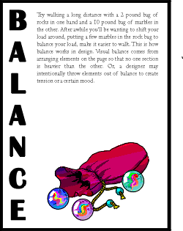
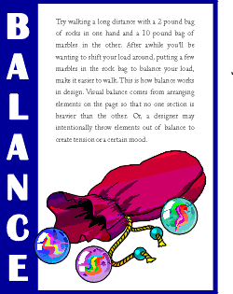
3. Create Balance
Which one looks more balanced? Why?
Resize/overlap items to show connection

Slide 7
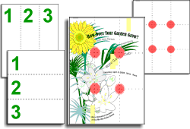
3: Balance and “Rule of Thirds”
Divide your page in thirds horizontally & vertically
Position important elements where those grids intersect

Slide 8
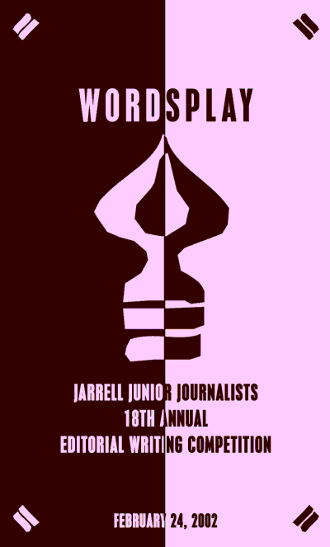
Balance - Symmetrical
Most formal style
Vertical thirds
  Title in top third
  Logo in middle third
  Detail in bottom third
Less creative

Slide 9

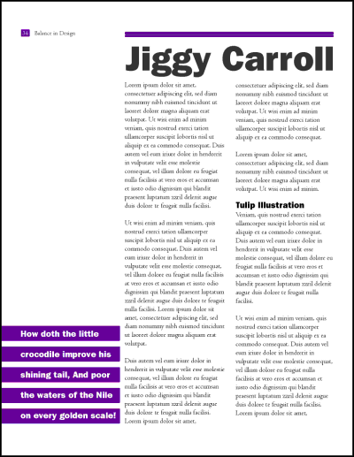
Balance - Asymmetrical
Has more elements in one third than the other thirds
  Top third
  Left third
Considered less formal
But more creative

Slide 10
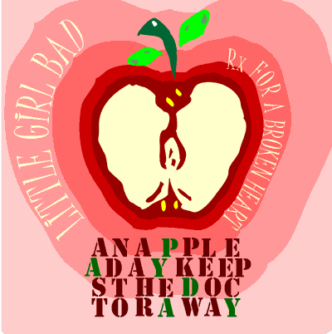
Balance - Radical
Avoids orderly columns or rows
Uses a spiral design
Who would this appeal to?

Slide 11
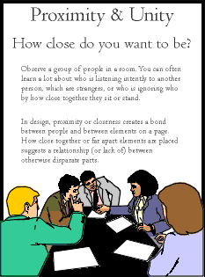
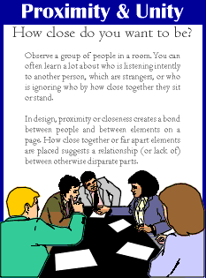
4: Proximity
Which is better?
Group related items together
  Headlines
  Subheads
Try using horizontal bars to separate different points/areas

Slide 12
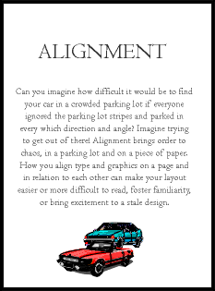
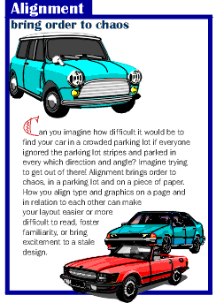
5. Alignment
Which alignment do you prefer?
  Left, center, or right
Alignment should aid in sending intended message
Centered alignments are more formal
Left alignments are easier to read

Slide 13
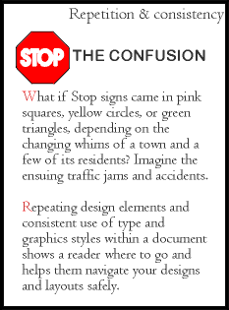
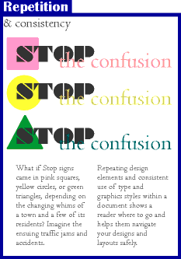
6. Repetition
Which is better? Why?
Where is there repetition?

Slide 14
7: Use Contrast
Between foreground and background colors
  Like this white text on dark background
Between fonts
  Arial / Times New Roman – too similar
  Wide Latin / Bookman Old Style – more contrast
Between font sizes
  25 pt Arial / 23 pt Arial – too similar
  32 pt Arial /20 pt Arial—more contrast

Slide 15
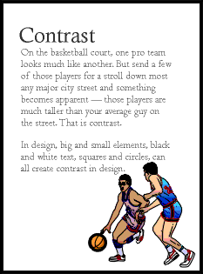
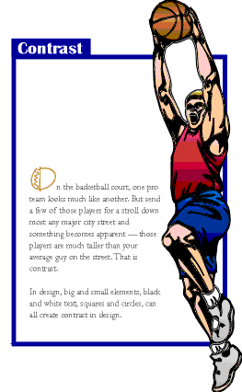
7. Contrast
Which is better? Why?
Oversized graphic provides contrast
Blue Box/White text provides contrast.

Slide 16
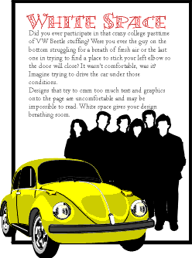
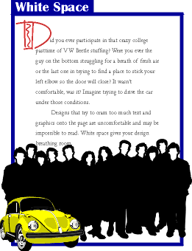
8: Leave Sufficient White Space
Which is better? Why?
Wider margins
Increased leading
(vertical
spacing)

Slide 17


Analyze Ads
Target Audience
Focal Point
Balance & Rule of Thirds
Proximity
Alignment
Repetition or consistency
Contrast
White space

Slide 18
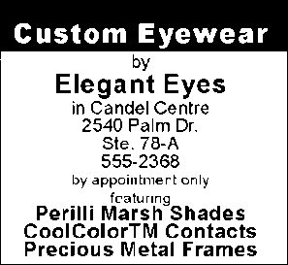
Your Assignment
Improve this ad
Use the 8 Elements of Design
Must be done in InDesign
You may “place” a graphic
Company name=Elegant Eyes--not Custom Eyewear

